Slide 1
Turtle – RDF Graph

Slide 2
Turtle – Basic Syntax
Triples are terminated with a full stop
URLs are encoded in angle brackets (< and >)
Literals are enclosed by double quotes
<http://example.com/thing> <http://example.com/relation> “Some Text”.

Slide 3
Turtle - Prefixes
Use @PREFIX to shorten URLs
  @PREFIX ex: <http://example.com>
  Which enables us to write
  ex:thing ex:relation “some text”

Slide 4

Turtle – Triples about same subject
  @PREFIX ex: <http://example.com/> .
  ex:thing ex:relation "Some Text" .
  ex:thing ex:otherrelation ex:otherthing .
can be written as:
  @PREFIX ex: <http://example.com/> .
  ex:thing ex:relation "Some Text" ;
  ex:otherrelation ex:otherthing .

Slide 5

Turtle – same properties
  @PREFIX ex: <http://example.com/> .
  ex:thing ex:relation "Some Text" .
  ex:thing ex:relation ex:otherthing .
can be written as:
  @PREFIX ex: <http://example.com/> .
  ex:thing ex:relation "Some Text" , ex:otherthing .

Slide 6
Turtle – Eliminate Redundant Triples
@PREFIX ex: <http://example.com/> .
ex:thing ex:relation "Some Text" .
ex:thing ex:relation "Some Text" .
  has same meaning as:
  @PREFIX ex: <http://example.com/> .
  ex:thing ex:relation "Some Text" .

Slide 7
Turtle – blank nodes
  @PREFIX ex: <http://example.com/> .
  _:a ex:relation "Some Text" .
'a' is the label - valid only within a single document
if above triple appeared in another document it would refer to different node

Slide 8

Turtle – unlabelled blank nodes
@PREFIX ex: <http://example.com/> .
ex:thing ex:relation _:a .
_:a ex:property "foo" .
_:a ex:property "bar“ .
is same as
ex:thing ex:relation [
ex:property "foo" ;
ex:property "bar" ] .

Slide 9
Turtle – literals with language
In RDF, literals can have a language
Written in Turtle as:
@PREFIX ex: <http://example.com/> . ex:thing ex:relation "Hello"@en .
ex:thing ex:relation "Bonjour"@fr .

Slide 10
Turtle – literal with datatypes
In RDF, literals can have a datatype
Written in Turtle as:
@PREFIX ex: <http://example.com/> . ex:thing ex:relation "49"^^<http://example.com/datatype> .
Can't have both a datatype and a language

Slide 11
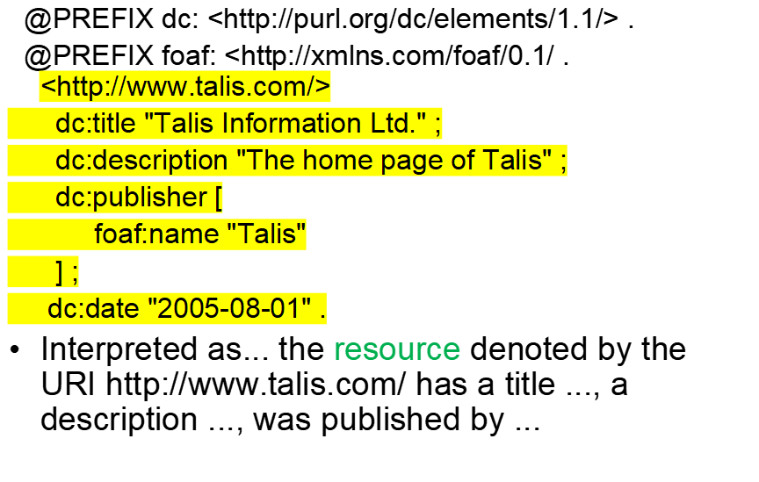

Turtle – Longer example

Slide 12
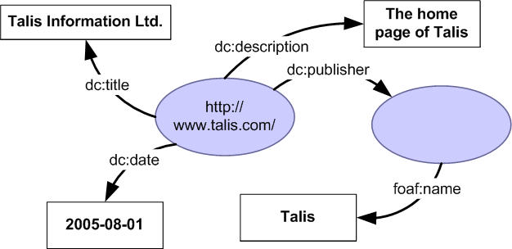
Turtle – Longer example

Slide 13
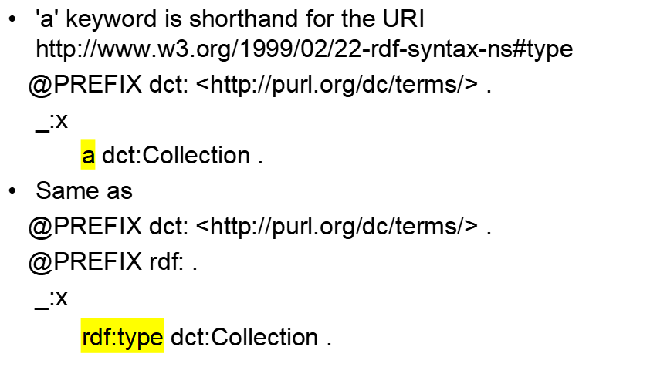
Turtle - Types

Slide 14
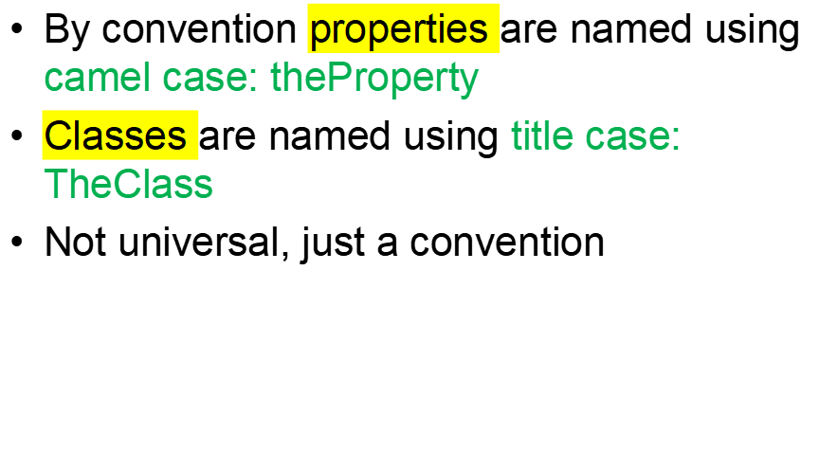
More on Turtle schemas

Slide 15
Turtle Schema example
Suppose we have this RDF schema:
@PREFIX rdf: <http://www.w3.org/1999/02/22-rdf-syntax-ns#> .
@PREFIX rdfs: <http://www.w3.org/2000/01/rdf-schema#> .
@PREFIX ex: <http://example.com/schema#> .
ex:Person a rdfs:Class .
ex:spouse a rdfs:Property .

Slide 16
Turtle Schema example
We could use it like this:
@PREFIX ex: <http://example.com/schema#> .
_:fred
a ex:Person ;
ex:spouse _:wilma .
A query for all things with type ex:Person would return fred

Slide 17
Adding a range
ex:Person a rdfs:Class .
ex:spouse a rdfs:Property ;
rdfs:range ex:Person .
Now whenever we use the property ex:spouse we can infer that the value is a ex:Person
A query against the data will now return wilma as well.

Slide 18
Adding a domain
We can simplify by adding a domain for the property
ex:Person a rdfs:Class .
ex:spouse a rdfs:Property ;
rdfs:range ex:Person .
rdfs:domain ex:Person .
Which lets us omit the type from our data - we can infer it instead
@PREFIX ex: <http://example.com/schema#> .
_:fred
ex:spouse _:wilma .
Fred is a person

Slide 19
Simple Example
http://umbc.edu/
~finin/talks/idm02/
dc:Title
“Intelligent Information Systems
on the Web”
dc:Creator
bib:Aff
http://umbc.edu/
bib:email
bib:name
“Tim Finin”
“finin@umbc.edu”

Slide 20



Note the prefix declarations
<rdf:RDF xmlns:rdf="http://www.w3.org/1999/02/22-rdf-syntax-ns#"
xmlns:dc="http://purl.org/dc/elements/1.1/"
xmlns:bib=http://daml.umbc.edu/ontologies/bib/>
<rdf:Description rdf:about="http://umbc.edu/~finin/talks/idm02/">
<dc:title>Intelligent Information Systems on the Web</dc:title>
<dc:creator>
<rdf:Description>
<bib:Name>Tim Finin</bib:Name>
<bib:Email>finin@umbc.edu</bib:Email>
<bib:Aff rdf:resource="http://umbc.edu/" />
</rdf:Description>
</dc:creator>
</rdf:Description>
</rdf:RDF>

Slide 21
N-triple representation
RDF can be encoded as a set of triples.
  <subject> <predicate> <object> .
  <http://umbc.edu/~finin/talks/idm02/> <http://purl.org/dc/elements/1.1/title> "Intelligent Information Systems on the Web" .
  <http://umbc.edu/~finin/talks/idm02/> <http://purl.org/dc/elements/1.1/creator> _:node17i6ht38ux1 .
  _:node17i6ht38ux1 <http://daml.umbc.edu/ontologies/bib/Name> "Tim Finin" .
  _:node17i6ht38ux1 <http://daml.umbc.edu/ontologies/bib/Email> "finin@umbc.edu" .
  _:node17i6ht38ux1 <http://daml.umbc.edu/ontologies/bib/Aff> <http://umbc.edu/> .

Slide 22


Turtle Example
@prefix rdf: http://www.w3.org/1999/02/22-rdf-syntax-ns# .
@prefix dc: http://purl.org/dc/elements/1.1/ .
@prefix bib: http://daml.umbc.edu/ontologies/bib/ .
<http://umbc.edu/~finin/talks/idm02/>
dc:title "Intelligent Information Systems on the Web" ;
dc:creator
[ bib:Name "Tim Finin";
bib:Email "finin@umbc.edu"
bib:Aff: "http://umbc.edu/" ] .

Slide 23
Triple Notes
RDF triples have one of two forms:
  <URI> <URI> <URI>
  <URI> <URI> <quoted string>
Triples are also easily mapped into logic
  <subject> <predicate> <object> becoming:
    <predicate>(<subject>,<object>)
    With type(<S>,<O>) becoming <O>(<S>)
  Example:
    subclass(man,person)
    sex(man,male)
    domain(sex,animal)
    man(adam)
    age(adam,100)
Triples are easily stored and managed in DBMS
  Flat nature of a triple a good match for relational DBs
; Note: we’re not
; showing the actual
; URIs for clarity

Slide 24
More Examples
@prefix rdfs: <http://www.....>.
@prefix : <genesis.n3>.
:parent rdfs:domain :Person;
  rdfs:range :Person.
  :mother
  rdfs:subProperty parent;
  rdfs:domain :Woman.
  :eve :mother :cain.
:parent a rdf:Property.
:Person a rdf:Class.
:Woman rdfs:subClassOf Person.
:mother a rdf:Property.
:eve a :Person;
a :Woman;
:parent :cain.
:cain a :Person.

Slide 25
example
Here’s how you declare a namespace.
<> Is an alias for the URI of this document.
This defines the “empty prefix” as refering to “this document”
@prefix rdf: <http://www.w3.org/1999/02/22-rdf-syntax-ns#>.
@prefix rdfs: <http://www.w3.org/2000/01/rdf-schema#>.
@prefix : <#> .
<> rdfs:comment “This is an N3 example”.
:Person a rdfs:Class.
:Woman a rdfs:Class; rdfs:subClassOf :Person.
:eve a :Woman; :age “100”.
:sister a rdf:Property; rdfs:domain :Person;
rdfs:range :Woman.
:eve :sister [a :Woman; :age 98].
:eve :believe {:eve :age “100”}.
[is :spouse of [is :sister of :eve]] :age 99.
:eve.:sister.:spouse :age 99.
“person is a class”. The “a” syntax is sugar for rdf:type property.
“Woman is a class and a subclass of person”. Note the ; syntax.
“eve is a woman whose age is 100.”
“sister is a property from person to woman”
“eve believes that her age is 100”. The braces introduce a reified triple.
“eve has a sister who is a 98 year old woman”. The brackets introduce an anonymous resource.
“the spouse of the sister of eve is 99”.
“the spouse of the sister of eve is 99”.

